Slide 1
Cell Size Limitations
Why are cells so small?

Slide 2
Why can’t organisms be one big giant cell?

Slide 3
Diffusion limits cell size
  Movement from higher concentration to lower concentration
  Larger the distance, slower the diffusion rate
  A cell 20 cm (8in) would require months for nutrients to get to the center
    This is about the size of a dinner plate
    http://www.youtube.com/watch?v=M30PrtZDB8I

Slide 4
DNA limits cell size
  Larger cells need more DNA.
    They need more of everything!
  Most cells have just one nucleus.
    There is not enough DNA to make all the stuff a cell needs if it gets too big.
    DNA Replication is complicated:
      http://www.youtube.com/watch?v=bW5JnYZImJA
      http://www.youtube.com/watch?v=teV62zrm2P0

Slide 5
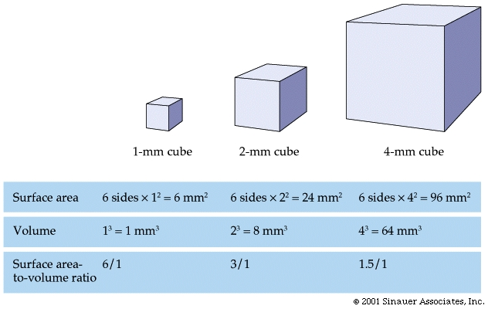
Surface area to volume ratio limits size

Slide 6
As volume increases, the surface increases.
The problem is that the volume increases more rapidly than surface area.
Cell size doubles, 8x as much volume, but only 4x as much surface area
  http://www.youtube.com/watch?v=xuG4ZZ1GbzI

Slide 7
So, if too big is a problem, what’s the solution?
  Cells divide before they become too big
Process of cell division is called mitosis

Slide 8
TO RECAP:
1. Diffusion limits cell size
  Slow and inefficient over large areas
2. DNA limits cell size
  Limit to how quickly DNA can be read
  Limit to # of proteins built / period of time
3. Surface area to volume ratio limits cell size
  Volume increases faster than surface area
  Requires more nutrients, get rid of more wastes but through a relatively smaller surface area –
  it is more difficult for things to get in and out!

