Slide 1
DNA
Edited by: Mr. Cistaro
01/13/13

Slide 2
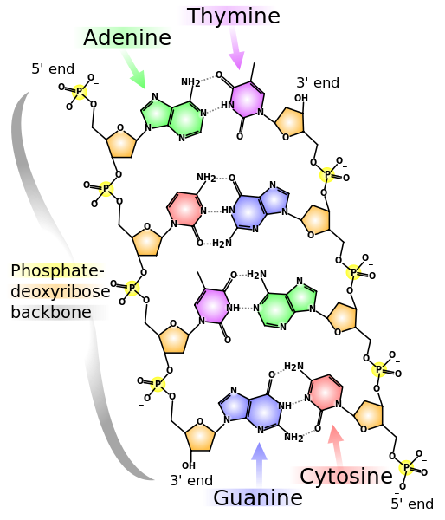
What is DNA?
Deoxyribonucleic Acid
Made up of 4 “chemical bases”
A=Adenine
G=Guanine
T=Thymine
C=Cytosine
Made up of 2 “backbones”
Sugar
Phosphate
The base bonds to the sugar

Slide 3
What is DNA?
When it comes to DNA…
A=Adenine ALWAYS BONDS TO T=Thymine
G=Guanine ALWAYS BONDS TO C=Cytosine

Slide 4
What does DNA do?
DNA contains all of the instructions necessary to build and operate a living organism and that DNA molecules can be found inside the cells of all living things.

Slide 5
What does this mean?
DNA is found inside the cells of all living things, and that the structure of the DNA molecule is the same in all living things.

Slide 6
What does this mean?
Because the structure of the DNA molecule is the same in all living things…
the diversity of life is the result of differences within the DNA sequence.

Slide 7
Before we move to our activity
Questions?

Slide 8
How does DNA replicate?
In DNA replication, the double-helix “ladder” is untwisted and the two strands are separated by breaking the hydrogen bonds between the base pairs.
Next, two new strands are made by reading each side of the DNA ladder, one step (base) at a time.
At each step, the matching base fills in (with its associated sugar and phosphate) to complete the rung and lengthen the new DNA strand. When the
When the process is complete, there are two identical DNA double-helices, each containing one original and one new strand.

