Slide 1
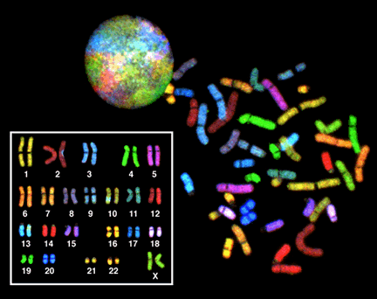
Genetic Disorders
Mr. Cistaro 01/09/13

Slide 2
Overview
Serious health issues can occur when there are problems with an organisms DNA.
Objectives:
1. What is a karyotype? 2. What is nondisjunction? 3. Distinguish between the chromosomal alterations that are involved in the following human disorders:
Down syndrome, Patau's syndrome, Edwards syndrome
Klinefelters syndrome, XYY syndrome
Trisomy X, Monosomy X

Slide 3
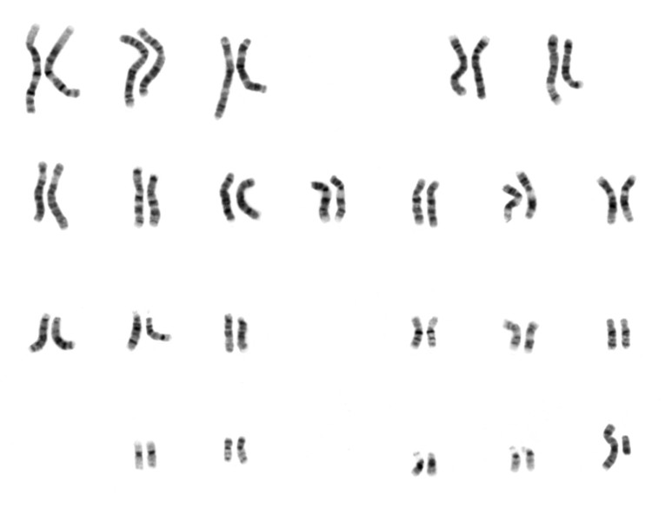
Key Terms
Karyotype
Genome
Nondisjunction
Autosomal
Sex-Linked
Haploid
Diploid
Polyploid

Slide 4
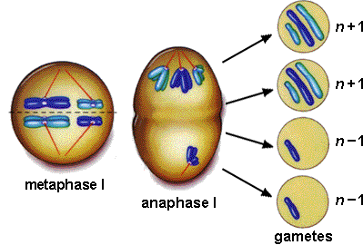
TURN TO YOUR NEIGHBOR
Let’s get out our textbooks and look up the definition of the key terms.
Like nondisjunction!

Slide 5
WHAT IS “NORMAL”
In HUMANS
46 chromosomes
Placed in 23 pairs
This is known as Diploid
In HUMAN sex cells
23 chromosomes
NOT in pairs
This is known as Haploid
2 of each chromosome
one from dad
one from mom

Slide 6
TURN TO YOUR NEIGHBOR
What is a normal karyotype in humans?
How many total chromosomes?
How many pairs?
How many from mom?
How many from dad?

Slide 7
PLOIDY
MONOPLOID/Monosomy refers to lack of one chromosome of the normal complement.
DIPLOID/Disomy is the presence of two copies of a chromosome. For organisms such as humans that have two copies of each chromosome (those that are diploid), it is the normal condition.
TRIPLOID/Trisomy refers to the presence of three copies, instead of the normal two, of a particular chromosome. The presence of an extra chromosome 21, which is found in Down syndrome, is called trisomy 21.

Slide 8
PLOIDY part II
POLYPLOID – Many chromosomes
Tetrasomy and pentasomy are the presence of four or five copies of a chromosome, respectively. Although rarely seen with autosomes, sex chromosome tetrasomy and pentasomy have been reported in humans, including XXXX, XXYY, XXXXX, XXXXY and XYYYY.

Slide 9
TURN TO YOUR NEIGHBOR
Explain:
Monosomy
Diploid
Trisomy

Slide 10
WHAT IS “NORMAL”

Slide 11
WHAT IS “NORMAL”

Slide 12
WHAT IS “NORMAL”

Slide 13
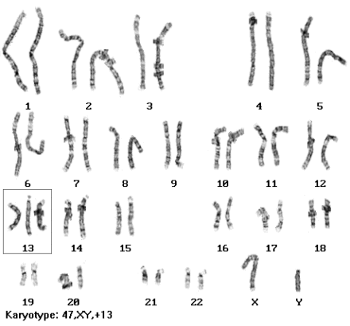
AUTOSOMAL DISORDERS
What’s wrong?

Slide 14
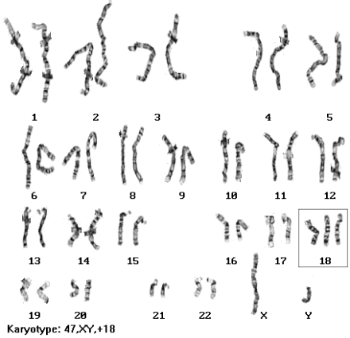
AUTOSOMAL DISORDERS
What’s wrong?

Slide 15
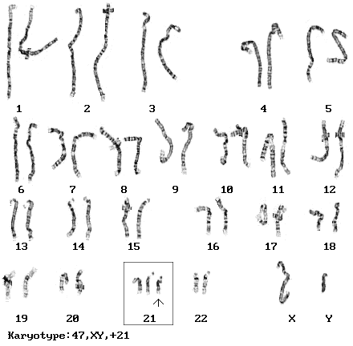
AUTOSOMAL DISORDERS
What’s wrong?

Slide 16
AUTOSOMAL DISORDERS
Trisomy 13
Patau’s Syndrome
Trisomy 18
Edward’s Syndrome
Trisomy 21
Down’s Syndrome
There are more, these are the more well-known ones and the ones you will be responsible to know.
See the class website for the fact sheet.

Slide 17
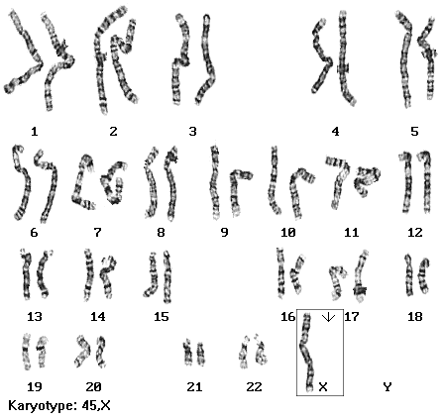
SEX-LINKED DISORDERS
What’s wrong?
Gonadal Dysgenesis

Slide 18
SEX-LINKED DISORDERS
What happens?
There are characteristic physical abnormalities, such as short stature, swelling, broad chest, low hairline, low-set ears, and webbed necks. Girls with Turner syndrome typically experience gonadal dysfunction (non-working ovaries), which results in amenorrhea (absence of menstrual cycle) and sterility. Health concerns are also frequently present, including congenital heart disease, hypothyroidism (reduced hormone secretion by the thyroid), diabetes, vision problems, hearing concerns, and many autoimmune diseases. Finally, a specific pattern of cognitive deficits is often observed, with particular difficulties in visuo-spatial, mathematical, and memory areas.

Slide 19
SEX-LINKED DISORDERS

Slide 20
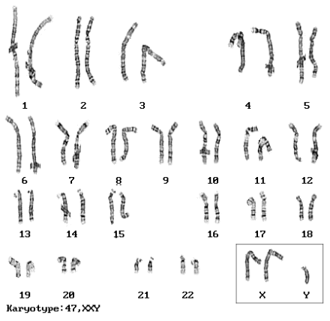
SEX-LINKED DISORDERS
What’s wrong?
Kleinfelter’s Syndrome

Slide 21
SEX-LINKED DISORDERS
What’s wrong?
Kleinfelter’s Syndrome
As babies and children, XXY males may have weaker muscles and reduced strength. As they grow older, they tend to become taller than average. They may have less muscle control and coordination than other boys their age.
During puberty, the physical traits of the syndrome become more evident; because these boys do not produce as much testosterone as other boys, they have a less muscular body, less facial and body hair, and broader hips. As teens, XXY males may have larger breasts, weaker bones, and a lower energy level than other boys

Slide 22
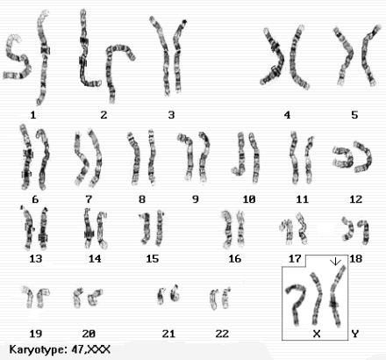
SEX-LINKED DISORDERS
What’s wrong?
Triple X Syndrome

Slide 23
SEX-LINKED DISORDERS
What’s wrong?
Triple X Syndrome
Triple X syndrome most often has only mild effects, or has no unusual effects at all. Symptoms may include tall stature; small head (microcephaly); vertical skinfolds that may cover the inner corners of the eyes (epicanthal folds); delayed development of certain motor skills, speech and language; learning disabilities, such as dyslexia; or weak muscle tone.The symptoms vary from person to person, with some women being more affected than others. There are seldom any observable physical anomalies in Triple X females, other than being taller than average.
Girls with Triple X syndrome are at increased risk of delayed language development, EEG abnormalities, motor-coordination problems and auditory-processing disorders, and scoliosis. They tend to show accelerated growth until puberty. Premature ovarian failure seems to be more prevalent in these women, but most Triple X women seem to have normal fertility.

Slide 24
HOW DOES THIS HAPPEN?
Alterations in chromosome structure:
Sometimes, chromosomes break, leading to 4 types of changes in chromosome structure:
1. Deletion: a portion of one chromosome is lost during cell division. That chromosome is now missing certain genes. When this chromosome is passed on to offspring the result is usually lethal due to missing genes.
Example - Cri du chat (cry of the cat): A specific deletion of a small portion of chromosome 5; these children have severe mental retardation, a small head with unusual facial features, and a cry that sounds like a distressed cat.

Slide 25
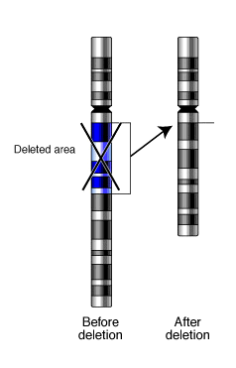
HOW DOES THIS HAPPEN?
Deletion

Slide 26
HOW DOES THIS HAPPEN?
2. Duplication: if the fragment joins the homologous chromosome, then that region is repeated
Example - Fragile X: the most common form of mental retardation. The X chromosome of some people is unusually fragile at one tip - seen "hanging by a thread" under a microscope. Most people have 29 "repeats" at this end of their X-chromosome, those with Fragile X have over 700 repeats due to duplications. Affects 1:1500 males, 1:2500 females.

Slide 27
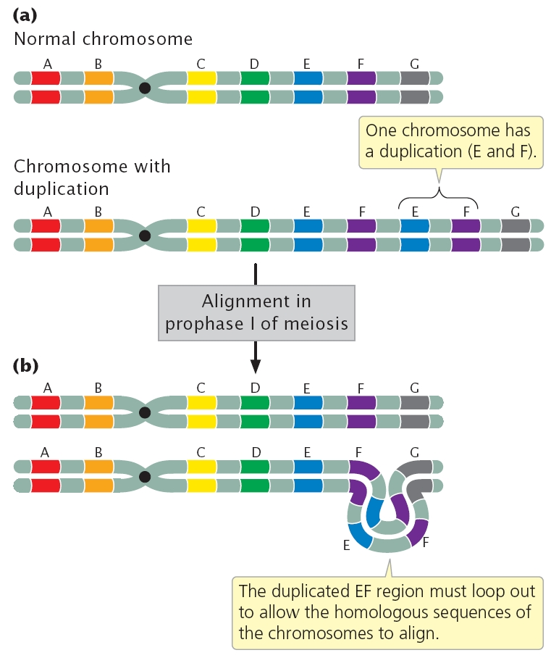
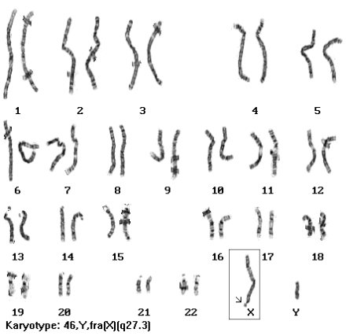
HOW DOES THIS HAPPEN?
Duplication

Slide 28
HOW DOES THIS HAPPEN?
3. Translocation: a fragment of a chromosome is moved ("trans-located") from one chromosome to another - joins a non-homologous chromosome. The balance of genes is still normal (nothing has been gained or lost) but can alter phenotype as it places genes in a new environment. Can also cause difficulties in egg or sperm development and normal development of a zygote.
Acute Myelogenous Leukemia is caused by this translocation:

Slide 29
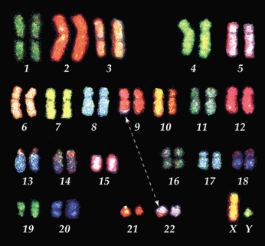
HOW DOES THIS HAPPEN?
Translocation

Slide 30
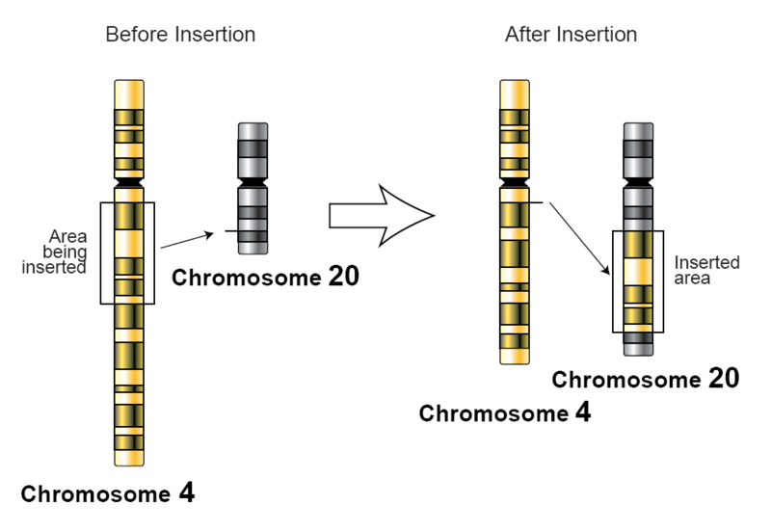
HOW DOES THIS HAPPEN?
Translocation

Slide 31
HOW DOES THIS HAPPEN?
4. Insertion: a nucleotide (DNA base) is inserted into the chromosome.
In this example, one nucleotide (adenine) is added in the DNA code, changing the amino acid sequence that follows.

Slide 32
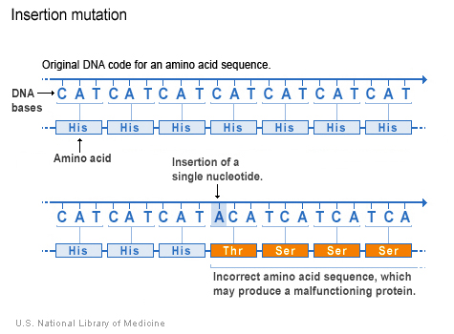
HOW DOES THIS HAPPEN?
Insertion

Slide 33
Questions

