Slide 1
Homologous vs. Analogous
But first, what is wrong with the picture below?
Take one minute.

Slide 2
WHAT IS HOMOLOGOUS?
Don’t make Mr. C cry.
Take 30 seconds and write down on your paper what Homologous means.

Slide 3
WHAT IS HOMOLOGOUS?
Most of you probably wrote something like, “It says the same thing.”
In anatomy, it is when organisms have a common underlying anatomy which was present in their last common ancestor.

Slide 4
WHAT IS HOMOLOGOUS?
The concept of homology is fundamental to the field of comparative biology.
In 1843, Richard Owen defined homology as "the same organ in different animals under every variety of form and function".
Homology is evaluated strictly in an evolutionary context.
REMEMBER, organs/pieces/parts in two species are homologous only if the same structure was present in their last common ancestor.

Slide 5
WHAT IS ANALOGOUS?
In anatomy, two anatomical structures are considered to be analogous when they serve similar functions but are not evolutionarily related, such as the legs of vertebrates and the legs of insects.

Slide 6
WHAT IS ANALOGOUS?
Analogous structures are the result of convergent evolution.
Convergence is where different species live in similar ways and/or similar environment, and thus face the same environmental factors.
Both herrings and dolphins are streamlined.
Both are active predators in a high drag environment, but the herring is a bony fish, the dolphin a mammal.

Slide 7
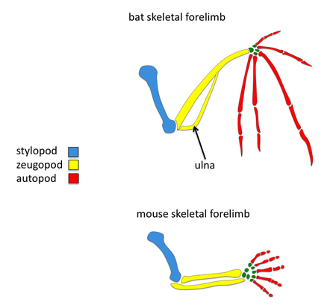
GAME TIME?
Homologous or Analogous?

Slide 8
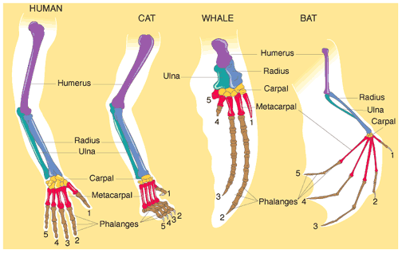
GAME TIME?
Homologous or Analogous?

Slide 9
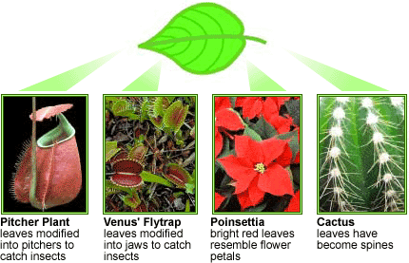
GAME TIME?
Homologous or Analogous?

Slide 10
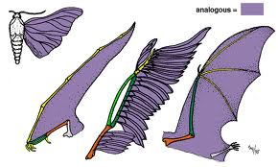
GAME TIME?
Homologous or Analogous?

Slide 11
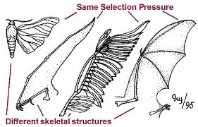
GAME TIME?
Homologous or Analogous?

Slide 12
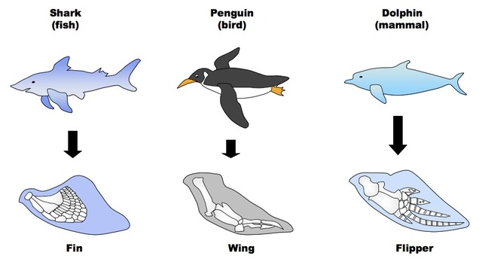
GAME TIME?
Homologous or Analogous?

Slide 13
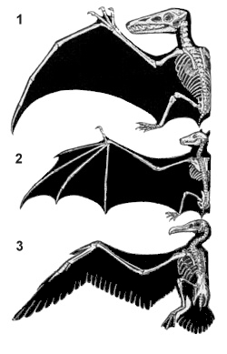
GAME TIME?
Homologous or Analogous?
Or BOTH?
Pterosaur
Bat
Bird

Slide 14
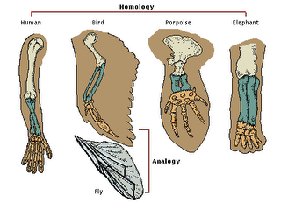
REMEMBER!
Homologous or Analogous?

Slide 15
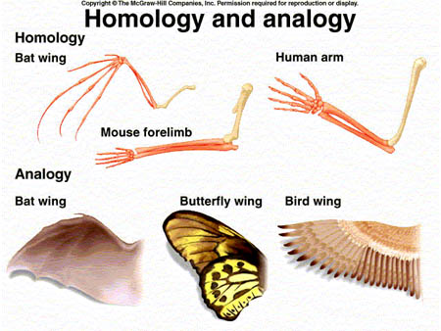
IT GOES LIKE THIS...
Homologous or Analogous:

Slide 16
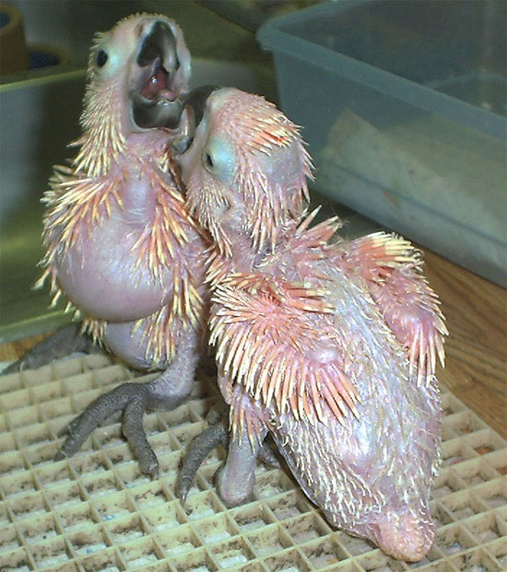
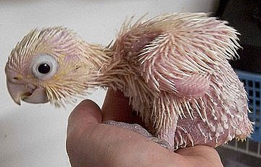
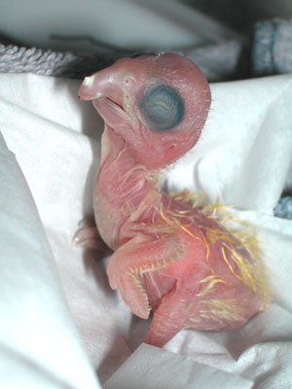
BABY BIRD!!!

Slide 17
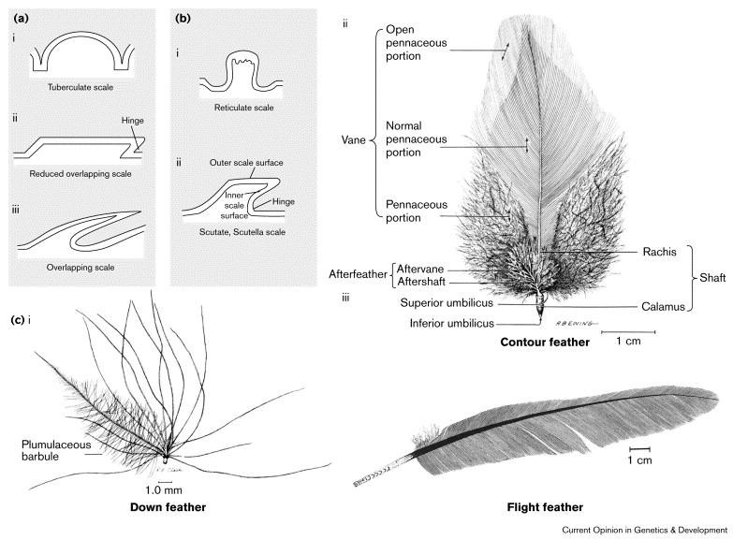
GAME TIME?
Are Feathers Homologous or Analogous?

Slide 18
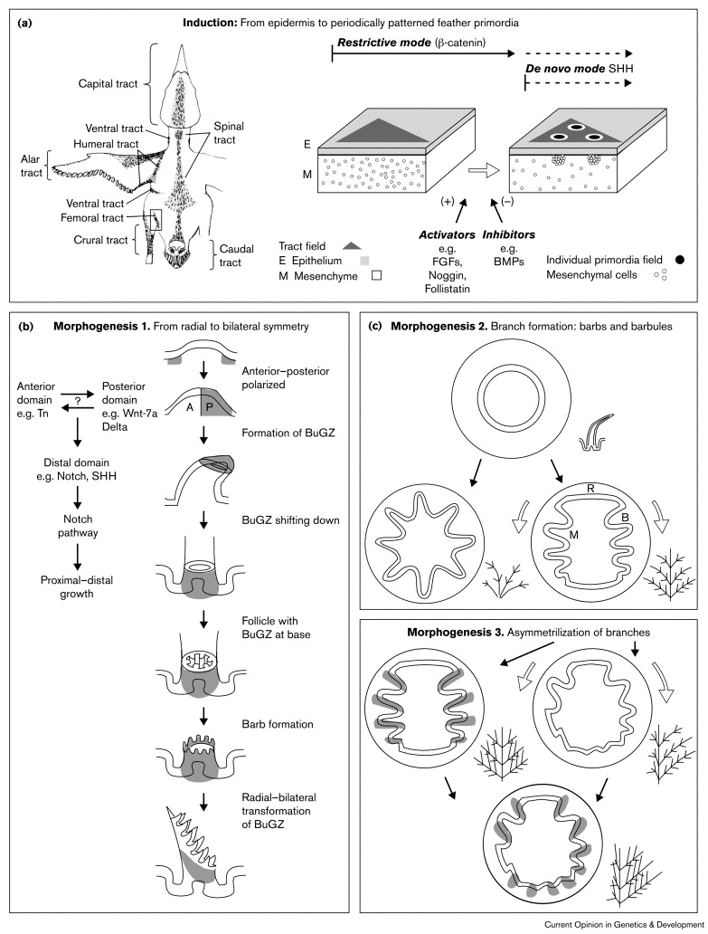
GAME TIME?
Are Feathers
Homologous or Analogous?
If they are Homologous,
what are they homologous
to?

Slide 19
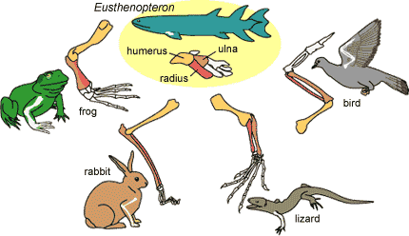
Where did it come from?
It doesn’t have to be the best, just good enough.

