Slide 1
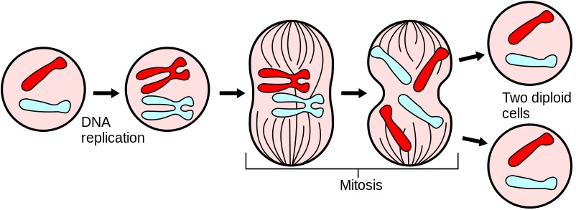
Mitosis
Mr. Cistaro 01/03/13

Slide 2
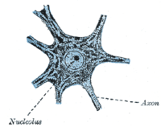
Overview
Mitosis is the process by which a eukaryotic cell separates the chromosomes in its cell nucleus into two identical sets in two nuclei.
The process of mitosis is complex and highly regulated. The sequence of events is divided into phases.
THE WHOLE POINT OF
MITOSIS IS TO ENSURE
(make sure) THAT EACH
NEW CELL GETS THE
CORRECT # OF CHROMOSOMES!

Slide 3
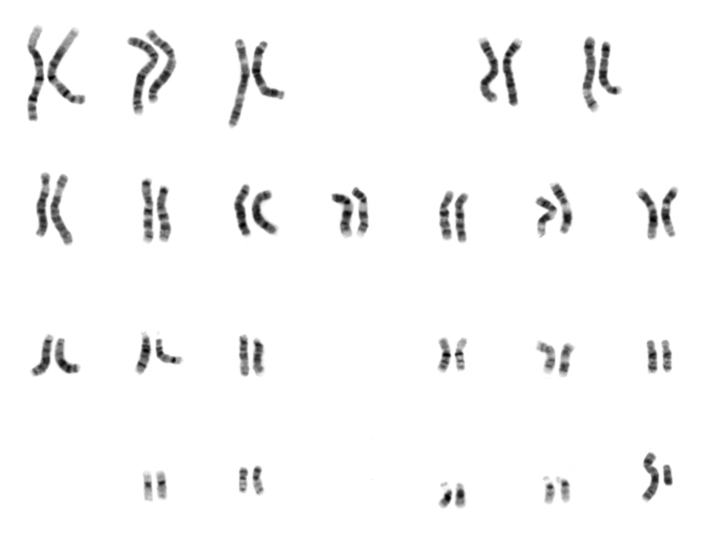
Key Terms
Karyotype
Interphase
G₁ Phase
S Phase
G₂ Phase
M Phase (Mitosis)
prophase
metaphase
anaphase
telophase
cytokinesis

Slide 4
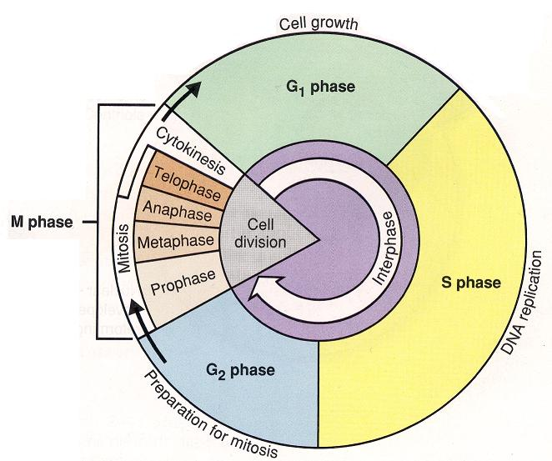
Cell Cycle Overview

Slide 5
G₁ PHASE (Interphase)
The first phase within interphase, from the end of the previous M phase until the beginning of DNA synthesis is called G₁ (G indicating gap). It is also called the growth phase. During this phase the biosynthetic activities (making stuff) of the cell, which had been considerably slowed down during M phase, resume at a high rate.

Slide 6
S PHASE (Interphase)
S phase starts when DNA replication commences (begins); when it is complete, all of the chromosomes have been replicated, i.e., each chromosome has two (sister) chromatids.
During this phase, the amount of DNA in the cell has doubled.

Slide 7
G₂ PHASE (Interphase)
The cell then enters the G₂ phase, which lasts until the cell enters mitosis.
Biosynthesis occurs during this phase, mainly involving the production of microtubules, which are required during the process of mitosis.
Inhibition (stop/prevent) of protein synthesis during G₂ phase prevents the cell from undergoing mitosis.

Slide 8
Mitosis / M Phase
Prophase: from the ancient Greek πρό (before) and φάσις (stage), is a stage of mitosis in which the chromatin condenses into double rod-shaped structures called chromosomes in which the chromatin becomes visible.

Slide 9
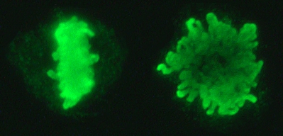
Mitosis / M Phase
Metaphase: from the ancient Greek μετά (adjacent) and φάσις (stage), is a stage of mitosis in the eukaryotic cell cycle in which condensed & highly coiled chromosomes, carrying genetic information, align in the middle of the cell before being separated into each of the two daughter cells.

Slide 10
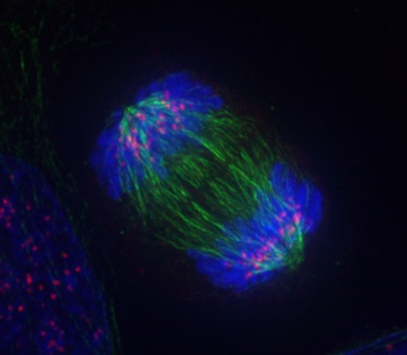
Mitosis / M Phase
Anaphase: from the ancient Greek ἀνά (up) and φάσις (stage), is the stage of mitosis when chromosomes are split and the sister chromatids move to opposite poles of the cell.

Slide 11
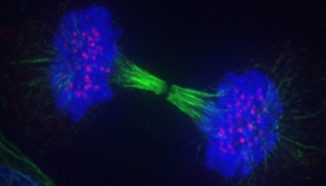
Mitosis / M Phase
Telophase: from the ancient Greek "τελος" (end) and "φασις" (stage), is the final stage mitosis in a eukaryotic cell.
Two daughter nuclei form in each daughter cell, and form nuclear envelopes around each.

Slide 12
Mitosis / M Phase
Cytokinesis: not part of mitosis but is an event that directly follows mitosis in which cytoplasm is divided into two daughter cells.
Usually happens at the same time as Telophase.

Slide 13
Questions

