Slide 1
RNA
Edited by: Mr. Cistaro
01/13/13

Slide 2
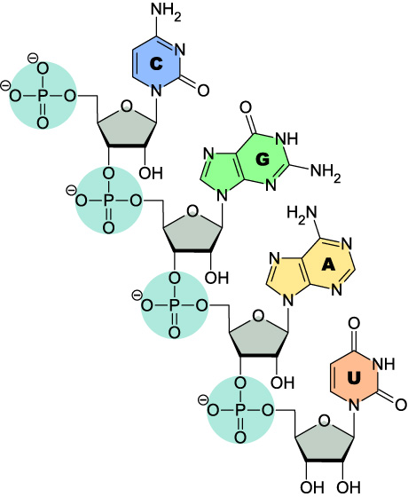
What is RNA?
Ribonucleic Acid
Made up of 4 “chemical bases”
A=Adenine
G=Guanine
T=Thymine
U=Uracil
C=Cytosine
Made up of 1 “backbone”
Sugar (Ribose)
Phosphate
The base bonds to the sugar

Slide 3
What is RNA?
When it comes to RNA…
A=Adenine ALWAYS BONDS TO U=Uracil
G=Guanine ALWAYS BONDS TO C=Cytosine

Slide 4
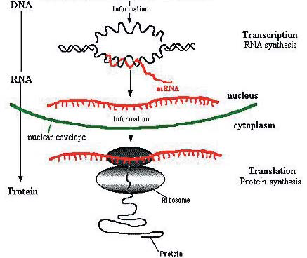
What does RNA do?
RNA reads the DNA, copies a gene (transcription) and moves to the ribosomes where it is “read” (translation).
Each 3 base pairs code for an amino acid.
Recall that a protein is made up of many amino acids.

Slide 5
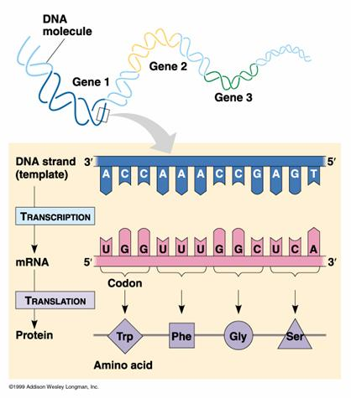
What does this mean?

Slide 6
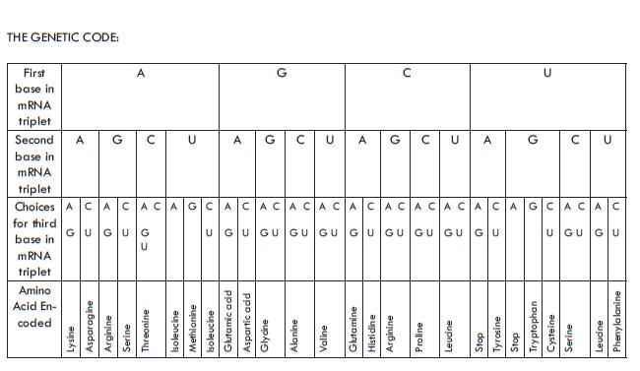
What does this mean?
Remember how the structure of the DNA molecule is the same in all living things?
Turns out that the Genetic Code is the same too!

Slide 7
To recap
After a cell has “chosen” a gene from which it will build a protein, it makes a copy of the information in the form of messenger ribonucleic acid (mRNA) to send to the protein-building machinery.
The synthesis of a RNA molecule from a DNA template is referred to as transcription.
The structure of RNA is very similar to DNA in that it has a sugar-phosphate backbone to which the chemical bases are attached.
However, there are some important differences:
(1) RNA is single-stranded and therefore does not form a double helix
(2) the sugar used to form the backbone is slightly different
(3) the chemical base thymine (T) is replaced by uracil (U)
The synthesis of amino acids from a RNA template is referred to as translation

Slide 8
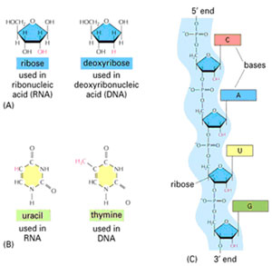
Before we move to our activity
Questions?

